Slide 1
Ontology in Smart Irrigation system

Slide 2
OWL
The Web Ontology Language (OWL) is a semantic web language designed to represent rich and complex knowledge about things, a group of things, and relations between things. It is also known as a
language designed to represent ontologies.

Slide 3
Ontologies
Ontologies are described as a way of showing the properties of a subject area and how they are related, by defining a set of concepts and categories that represent the subject.
Three components of ontologies,
Concepts
Relationships
Instances

Slide 4
Concepts -- Concepts represent a set of classes or entities or things within a domain, which are used to classify individuals or other classes or a combination of both.
Instances -- Instances are used to refer to the things represented by the concept. It may include concrete objects such as people, animals, tables, or abstract individuals such as numbers and words.
Relationship -- Relationship specifies how objects are related to one another.

Slide 5
Two types of properties in ontology
Object Property - Object Property define relation between classes. It is used to link individuals to individuals.
Datatype Property - Datatype Property define relation between classes and literal values. It can have datatype as the range and are used to link individuals to data values.

Slide 6
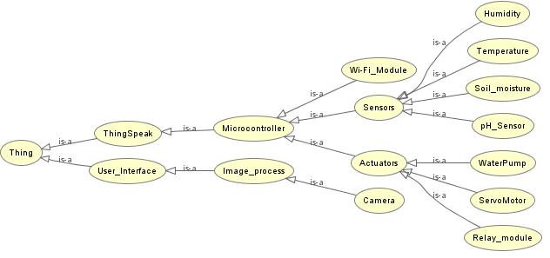
Ontology in Smart Agriculture

Slide 7
Conclusion
It enables efficient data integration, supports intelligent decision-making, facilitates knowledge sharing, and promotes sustainable approaches.
By harnessing the power of ontology, smart agriculture systems can optimize resource usage, improve agricultural productivity, and contribute to a more sustainable food production system.

